Slide 1
Human Immunodeficiency virus

Slide 2
OBJECTIVES
What is the definition of AIDS ?
Describe the structure of HIV ?
What are the most common routes of transmission of HIV?
How does HIV replicate and cause damage to the immune system?
What problems are there in the development of an effective vaccine against AIDS?

Slide 3
Human immunodeficiency virus (HIV) is the cause of acquired immunodeficiency syndrome (AIDS) which defined as:
HIV infection in an individual with a CD4+ cell count of <200 cells per cubic mm of blood.

Slide 4
Classification
Retroviridae family
Lentivirus subgroup
Human immunodeficiency virus (HIV) types.
HIV1
HIV2
HIV2 causes milder, slower to progress and poorly transmitted vertically. HIV1 causes most of the disease world wide (pandemic).

Slide 5
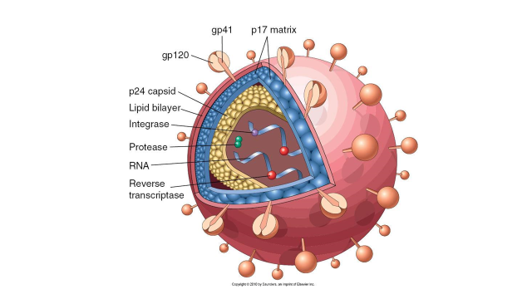
Structure of HIV
Cylindrical nucleoid
capsid protein: p24
two copies of single stranded,
positive sense RNA .
reverse transcriptase (RT), RNase H
integrase and protease.
A protein matrix underlying the envelope
formed by p17.

Slide 6
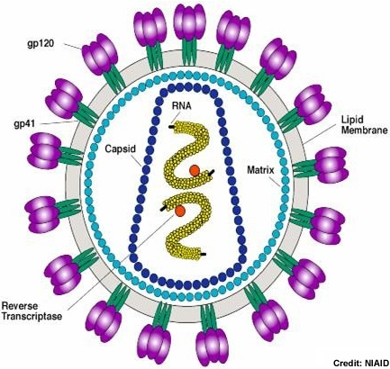
The envelope : glycoprotein spikes (gp160)
gp120 external major glycoprotein : binds to CD4 and coreceptors (CCR5 and CXCR4)
gp41 a transmembrane segment mediate fusion between the cellular and viral membranes.

Slide 7
Genome
Three structural genes :
Gag (Group Specific Antigen) : p24, p7, p17
Env (Envelope) : gp 120, gp 41
Pol (Polymerase) : Reverse transcriptase, integrase, protease.
Up to six Regulatory genes found in HIV

Slide 8
Receptors
The virus is especially tropic to CD4+ T cells, but any cells expressing CD4 are susceptible to HIV infection ; like monocytes, macrophages, dendritic cells and microglia cells of the nervous system.
A second coreceptor in addition to CD4 is necessary for HIV-1 to gain entry to cells, which is required for fusion of the virus with the cell membrane.
CCR5 is the predominant coreceptor for macrophage-tropic strains of HIV-1.
CXCR4, is the coreceptor for lymphocyte-tropic strains of HIV-1.

Slide 9
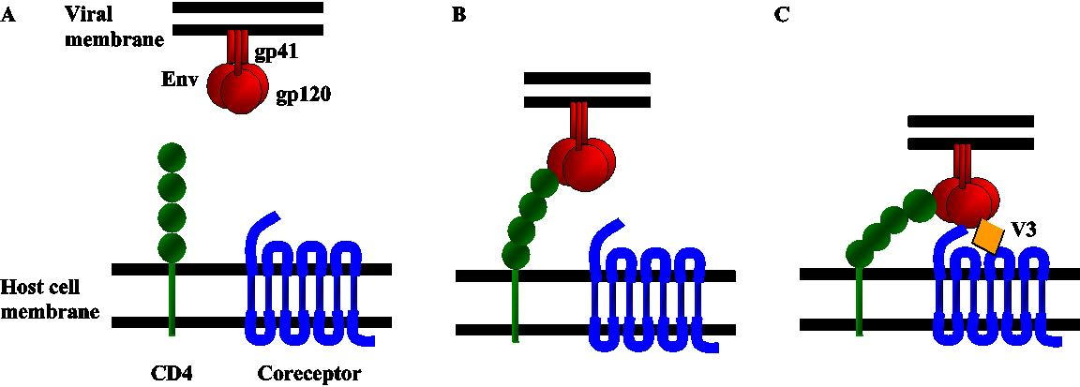

Slide 10
Tropism
M- tropic strains of the virus predominates early in infection and its believed that macrophages and monocytes serves as major reservoir for HIV in the body, unlike the CD4+ T cells , the monocyte is relatively resistant to the cytopathic effect of HIV.

Slide 11
Transmission and Epidemiology
sexual contact .
Transfer of contaminated blood or blood products, I.V drugs.
Perinatal transmission
across placenta
at birth 50%
breast feeding
Patients with sextually transmitted disease at higher risk.
Screening of donated blood for HIV antibodies greatly reduce the HIV transmission.
Blood banks now test for presence of p24 antigen.

Slide 12
Clinical stages
1.Acute
2.Latent
3.Disease

Slide 13
1. Acute stage
a 4- to 11-day period between mucosal infection and initial viremia; which is detectable for about 8–12 weeks. Virus is widely disseminated throughout the body during this time, and the lymphoid organs become seeded.
An acute mononucleosis-like syndrome develops in many patients 3–6 weeks after primary infection.
There is a significant drop in numbers of circulating CD4 T cells at this early time. An immune response to HIV occurs 1 week to 3 months after infection, plasma viremia drops, and levels of CD4 cells rebound. However, the immune response is unable to clear the infection completely, and HIV-infected cells persist in the lymph nodes.

Slide 14
2. Clinical latency
may last for as long as 10 years.
The patient is asymptomatic.
high level of ongoing viral replication.
high turnover rates of CD4 T lymphocytes .
the inherent error rate of the HIV reverse transcriptase

Slide 15
3.Clinical disease
opportunistic infections or neoplasms.
Higher viral load
CD4 T cell counts have dropped to less than 200 cells/L
more virulent and cytopathic
a shift from (M-tropic) strains of HIV-1 to (T-tropic) variants accompanies progression to AIDS

Slide 17
Opportunistic Infections
occur when the CD4 T cell counts have dropped to less than 200 cells/L
Protozoa: Toxoplasma gondii,
Isospora belli,
cryptosporidium species.
(2) Fungi: Candida albicans,
Cryptococcus neoformans,
Coccidioides immitis,
Histoplasma capsulatum,
Pneumocystis jiroveci.

Slide 18
(3) Bacteria: Mycobacterium avium-intracellulare
Mycobacterium tuberculosis,
Listeria monocytogenes,
Nocardia asteroides,
salmonella species,
streptococcus species.
(4) Viruses: Cytomegalovirus,
herpes simplex virus,
varicella-zoster virus,
adenovirus,
polyomavirus JC virus,
hepatitis B virus and hepatitis C virus.

Slide 19
AIDS-associated cancers include:
Hodgkin's lymphoma and non-Hodgkin's lymphoma (both systemic and central nervous system types),
Kaposi's sarcoma
cervical cancer
anogenital cancers

Slide 20
Laboratory Diagnosis
Evidence of infection by HIV can be detected in three ways:
serologic determination of antiviral antibodies
PCR tests
Virus isolation (culture)

Slide 21
Serology
Enzyme-linked immunoassay (ELISA) for detection of antibodies to p24 protein as a presumptive diagnosis.
Western blot (Immunoblot) analysis a confirmation test is performed in which the viral proteins are displayed by acrylamide gel electrophoresis, transferred to nitrocellulose paper (the blot), and reacted with the patient’s serum.
The response pattern against specific viral antigens changes over time as patients progress to AIDS. Antibodies to the envelope glycoproteins (gp41, gp120, gp160) are maintained, but those directed against the Gag proteins (p17, p24, p55) decline. The decline of anti-p24 may herald the beginning of clinical signs and other immunologic markers of progression.

Slide 22
PCR test
very sensitive and specific technique .
plasma HIV RNA levels (Viral load) are important predictive markers of disease progression and monitor the effectiveness of antiviral therapies.
Early diagnosis of HIV infection in infants born to infected mothers . The presence of maternal antibodies makes serologic tests uninformative.
Low levels of circulating HIV-1 p24 antigen can be detected in the plasma by EIA soon after infection but, the antigen often becomes undetectable after antibodies develop (because the p24 protein is complexed with p24 antibodies) but may reappear late in the course of infection.

Slide 23
Culture
HIV can be cultured from clinical specimens
Is available only at a few medical centers because they are time-consuming and laborious
limited to research studies.

Slide 24
Treatment
No drug regimen results in a cure (eradication of the virus) but long term suppression can be achieved
Treatment of HIV typically involves multiple antiretroviral because of high rate of mutation to drug resistance.
Highly active antiretroviral therapy (HAART) the standard treatment consist of one of four regimen , all of which consist of a combination of at least three drugs that suppress HIV replication.
HAART is effective in prolonging life, improving quality of life and reducing viral load.

Slide 25
Classes of drugs
Nucleoside /Nucleotide reverse transcriptase inhibitors NRTIs
Emtricitabine, Didanosine/Tenofovir
Nonnucleosides Reverse Transcriptase Inhibitors
efavirenz
The protease inhibitors: are potent antiviral drugs because the protease activity is absolutely essential for production of infectious virus, and the viral enzyme is distinct from human cell proteases.
When combined with nucleoside analogues are very effective in inhibiting viral replication and increasing CD4 cell count.
Commonly used in HAART regimens.
Ritonavir, Atazanavir

Slide 26
Fusion inhibitors blocks virus entry into cells.
binds to viral gp41and blocks fusion of virus with cell membrane.
enfuvirtide.
Integrase inhibitors; inhibit integration of proviral DNA into cellular DNA
Raltegravir

Slide 27
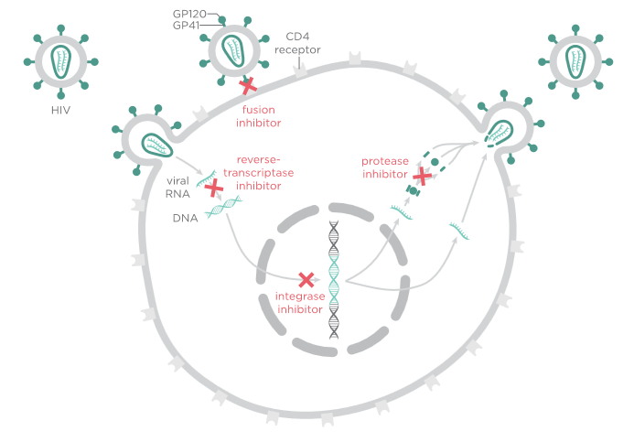

Slide 28
Prevention
No vaccine is available.
Multiple trial have failed to induce protective antibodies , protective cytotoxic T cells or mucosal immunity
because HIV mutates rapidly, is not expressed in all cells that are infected, and is not completely cleared by the host immune response after primary infection.

Slide 29
Prevention
Pre exposure prophylaxis PrEP
Taking measures to avoid exposure to the virus e.g using condoms, not sharing needles, blood testing .
Post exposure prophylaxis PEP, such as that given after a needle stick injury employ three drugs regimens given soon after exposure and continue for 28 days.
To reduce HIV infection in children
Antiretroviral therapy should be given to HIV infected mothers and neonates.
Cesarean section lower the risk of neonatal infection than vaginal delivery.
HIV infected mothers should not breast feed.

